Slide 1
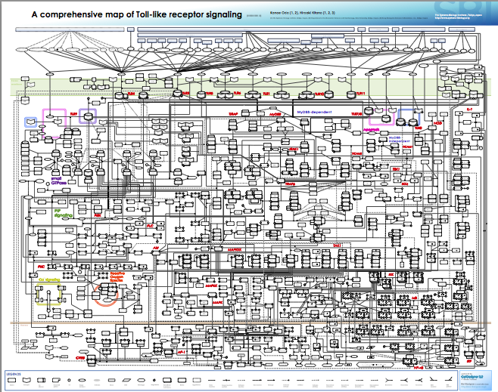
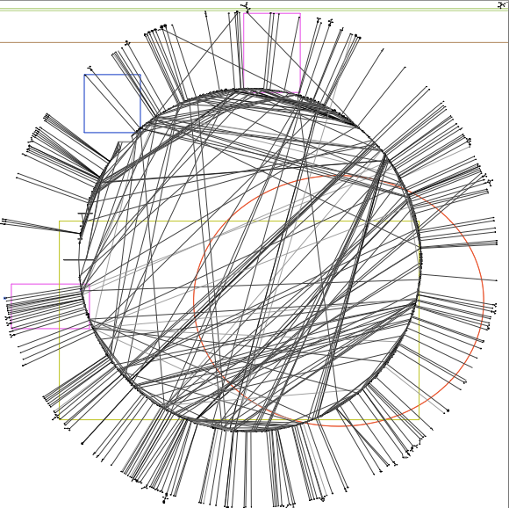
Innate immune signaling network are complex
TLRs: 11
No of species: 652
No of edges: 444

Slide 2

But we can find features from these complex network
-- double bow-tie
Notes:
http://www.nature.com/ni/journal/v4/n12/fig_tab/ni1203-1162_F1.html
Key node.

Slide 3
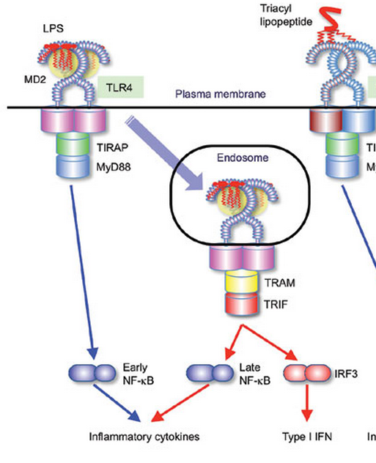
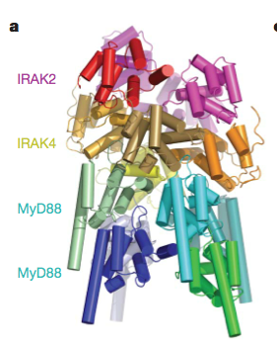
TLR4 is special
Dynamical features in the sub-pathways
Molecular details in shaping the dynamics
Notes:
Single cells and population: Gave more fundamental molecular mechanism.
Auto/para-crine feedback via TNF (limited to MEFs).
First 4 hours at most.

Slide 4
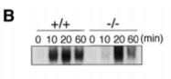
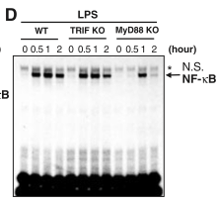
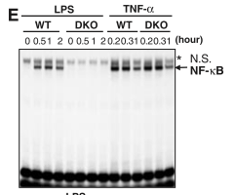
Dynamics in terms of the sub-pathways

Slide 5
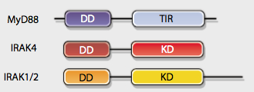
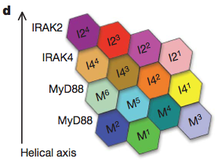
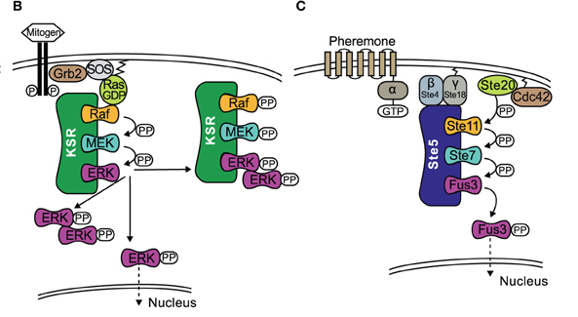
How molecular mechanisms helps in shaping the dynamics.
Notes:
Yeast mapk scaffold protein.
http://www.frontiersin.org/Journal/10.3389/fphys.2012.00475/full

Slide 6
The TLR4 model diagram
3 compartments
41 species
Reactions
Notes:
Need reaction maps.

Slide 7
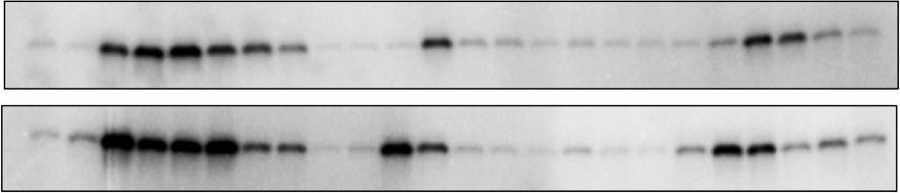
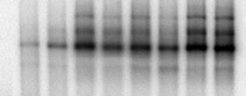
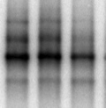
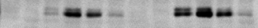
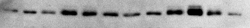
Model validation and experimental data
B
WT
trif ^{- /-}
myd88^{- / -}
LPS
15
120
120
120
min
30
45
60
90
15
30
45
60
90
15
30
45
60
0
90
5
0
5
0
5
1 ng/ml
IKK
100ng/ml
1 ng/ml LPS
100 ng/ml LPS
120
min
240
120
10
30
60
10
240
0
30
60
NF-κB_{n}
1 ng/ml LPS
100 ng/ml LPS
0
10
30
60
120
240
0
10
30
60
120
240
min
IRF3_{np}
IRF3_{n}
C
D
IKK
NFκBn
0.8
wt exp.
0.8
wt sim.
0.4
0.4
0
0
20
40
60
80
100
120
0
Level (Normalized to maximum)
Level (Normalized to maximum)
Time (min)
0
30
60
90
120
150
180
210
240
0.6
IRF3_{np}
0.8
wt exp.
0.4
wt sim.
0.2
0.4
0
0
20
40
60
80
100
120
0
0
30
60
90
120
150
180
210
240
Time (min)
Time (min)
Red: 100 ng/ml LPS; Blue: 1 ng/ml LPS
Red: 100 ng/ml LPS; Blue: 1 ng/ml LPS
wt exp.
wt sim.
mko exp.
mko sim.
tko exp.
tko sim.
Diana
Notes:
Always to question about how big your parameter space is. And how robustness about the parameter set.

Slide 8
Dynamics features in sub-pathways: duration, responsive speed
A
B
0.12
NFκBn
240
Response duration
Both
0.1
TRIF pathway
MyD88 pathway
180
0.08
NFκBn (μM)
Response duration (min)
0.06
120
0.04
60
0.02
0
0
0
60
120
180
240
10⁻¹
10⁰
10¹
10²
C
Time (min)
D
LPS dose (ng/ml)
Response speed
Time of the maximum response
60
60
50
50
40
40
Half peak time (min)
Peak time (min)
30
30
20
20
10
10
0
0
10⁻¹
10⁰
10¹
10²
10⁻¹
10⁰
10¹
10²
LPS dose (ng/ml)
LPS dose (ng/ml)
Notes:
Total NFkBn above threshold. TO DO

Slide 9
Myddosome formation produce threshold in signaling activation.
A
A
0.8
0.6
M^{ss}₆/M₀
B
0.4
0.2
Threshold
M^{ss}₆/M₀
3.2
B
0
0.8
3
1
2.8
Hill coefficient (n)
0.8
0.6
2.6
2.4
0.6
2.2
k_{f}/k_{b}
0.4
2
0.4
0
0.2
0.4
0.6
0.8
1
k_{f} /k_{b}
0.2
0.2
0
0
0
0.2
0.4
0.6
0.8
1
C₀/M₀
Notes:
Myddosome formation produce threshold in signaling activation.
Steepness is in the range of 2 to 3.2.

Slide 10
Response speed is most sensitive to the threshold.

Slide 11
A
TLR4
Cytoplasm
MyD88
MyD88*
Constitutive
Ligand-induced
Endosome
B
TRIF
TRIF*
0.12
Constitutive shuttle only
240
Response duration
Time of the maximum response
Both
120
0.1
TRIF pathway
180
90
0.08
MyD88 pathway
NFκBn (μM)
Response duration (min)
Response duration (min)
0.06
120
60
0.04
0.02
60
30
0
0
0
0
60
120
180
240
10⁻¹
10⁰
10¹
10²
10⁻¹
10⁰
10¹
10²
C
Time (min)
LPS dose (ng/ml)
LPS dose (ng/ml)
0.12
Ligand-induced shuttle only
240
Response duration
Time of the maximum response
Both
120
0.1
TRIF pathway
180
90
0.08
MyD88 pathway
NFκBn (μM)
Response duration (min)
Response duration (min)
0.06
120
60
0.04
0.02
60
30
0
0
0
0
60
120
180
240
10⁻¹
10⁰
10¹
10²
10⁻¹
10⁰
10¹
10²
Time (min)
LPS dose (ng/ml)
LPS dose (ng/ml)
Notes:
Constitutively shuttling vs. ligand-induced shuttling

Slide 12

B
NFκBn
C
NFκBn
1
1
1
1
50
0.8
50
0.8
A
0.6
0.6
100
100
f_{m}
0.4
0.4
150
0.2
150
0.2
MyD88
MyD88*
200
0
200
0
0
60
120
180
240
0
60
120
180
240
D
Time (min)
E
Time (min)
f_{t}
1
LPS 1
1
LPS 2
TRIF
TRIF*
Activation efficiency
Activation efficiency
0.5
0.5
0
0
MyD88 pathway
(f_{m})
TRIF pathway
(f_{t})
MyD88 pathway
(f_{m})
TRIF pathway
(f_{t})
Notes:
Randomize this figure.

Slide 13
A
B
C
D

Slide 14
Conclusions:
Notes:
Conclusions:

Slide 15
TNF
CpG
LPS
dsRNA
TNFR
TLR9
TLR4
TLR3
Werner et al
G&D 2008
MyD88
TRIF
IKK
TBK
TNF
Production
Werner et al
Science 2005
NF-κB
IRF3
TNF
IFNβ
κB
κB
ISRE

Slide 16
TNF production
Notes:
TNF production
Through multiple level of regulation and it’s myd88 and trif dependent.

